Slide 1

Austin Crime Analysis
By: Rudy Duran

Slide 2

Overview
Background
Purpose
Data Description
Questions
Data Cleansing
Data Splitting
Methodology
Analysis
Recommendations

Slide 3
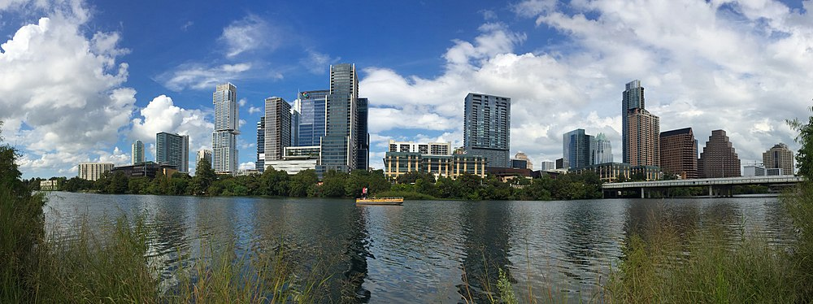
Background
Capital of Texas
Population: 975,000 and growing
City Slogan: The Live Music Capital of the World
Vibrant Economy
Facebook, Amazon, Google
Suitable for data analysis
Growing population
Economy

Slide 4

Purpose
Provide recommendations to APD
Reveal insights
Reduce crime
Reproducible Research
Application in other cities
Ensure safety of citizens

Slide 5
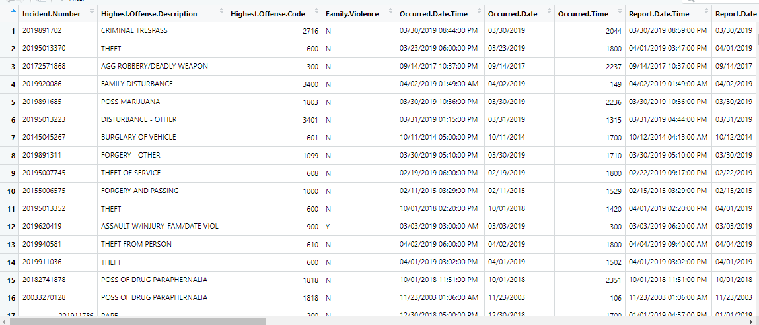
Data Description
Austin Crime Dataset (2002- 2019)
Observations: 2,124,418
Variables: 27
Data Types:
Integer
Character
Numeric
Timestamp
Longitude
Latitude

Slide 6
Questions
Which crimes are reported the highest within the city?
Which crimes are more likely to occur in Austin depending on the month and quarter?
Which locations are most associated with high crime rates?
Which areas in Austin are more affected by severe crime incidents?
Is it possible to predict whether crime will be associated with family violence?

Slide 7


Slide 8
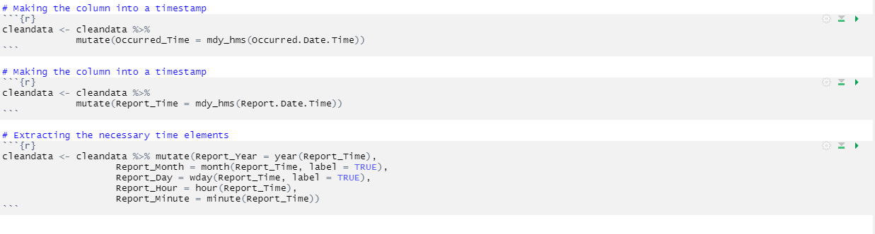
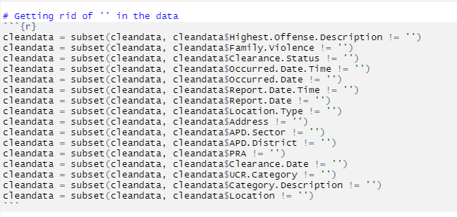
Data Cleansing
Missing values
NAs
Empty Quotations
Dummy variable creation
Weekdays
Months
Creating Factors
Generating Date Fields
Month
Day
Year

Slide 9
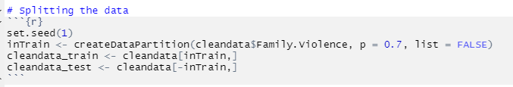
Data Splitting
70/30 split
38 variables for each set (test/train)
Data used from 2015-2019
Not all variables were used
Variable mutations occurred
Time stamp data
Dummy variables
101,963 observations for training
43,697 observations for testing
Imbalanced data
More N’s than Y’s

Slide 10

Methodology
Visualizations
Bar Graphs
Line Graphs
Maps
Inferential Models
Logistic Regression
Random Forest

Slide 11
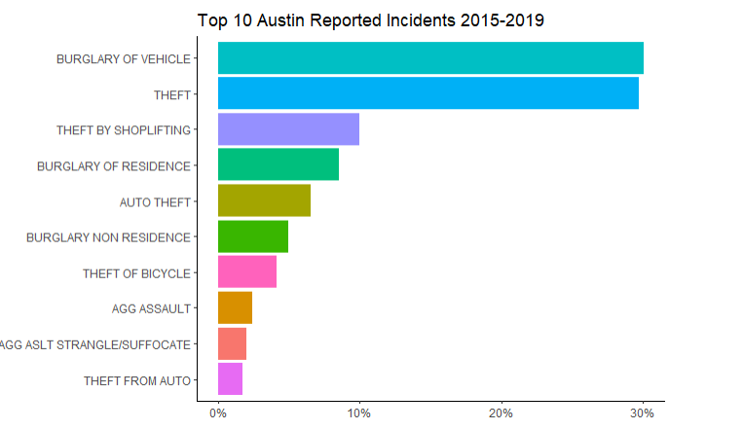
Analysis – Question 1
Which offenses are reported the highest within the city?

Slide 12
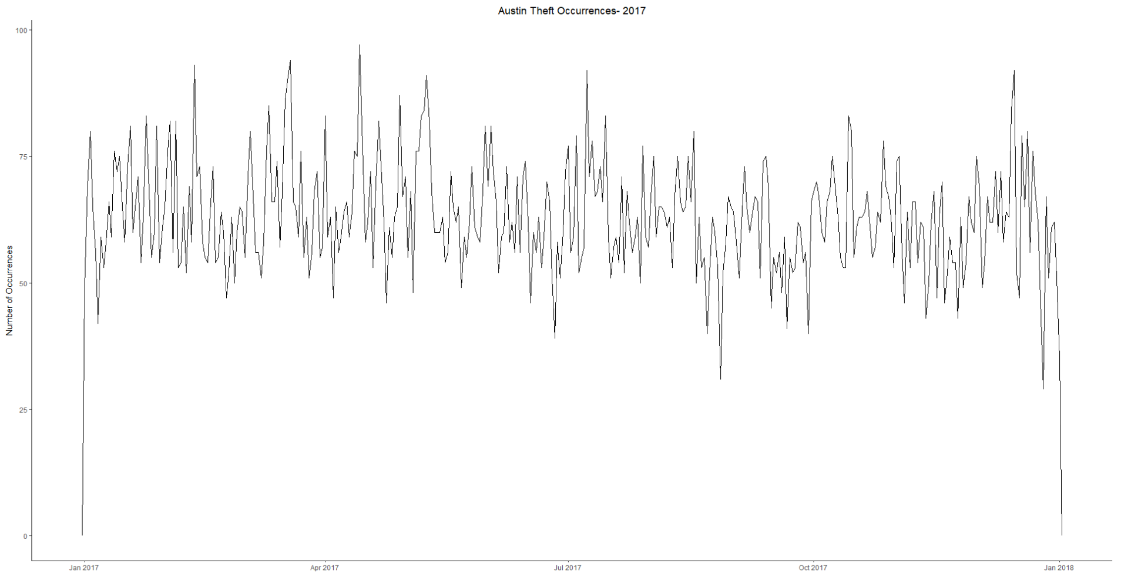
Question 2
Which crimes are more likely to occur in Austin depending on the month and quarter?

Slide 13
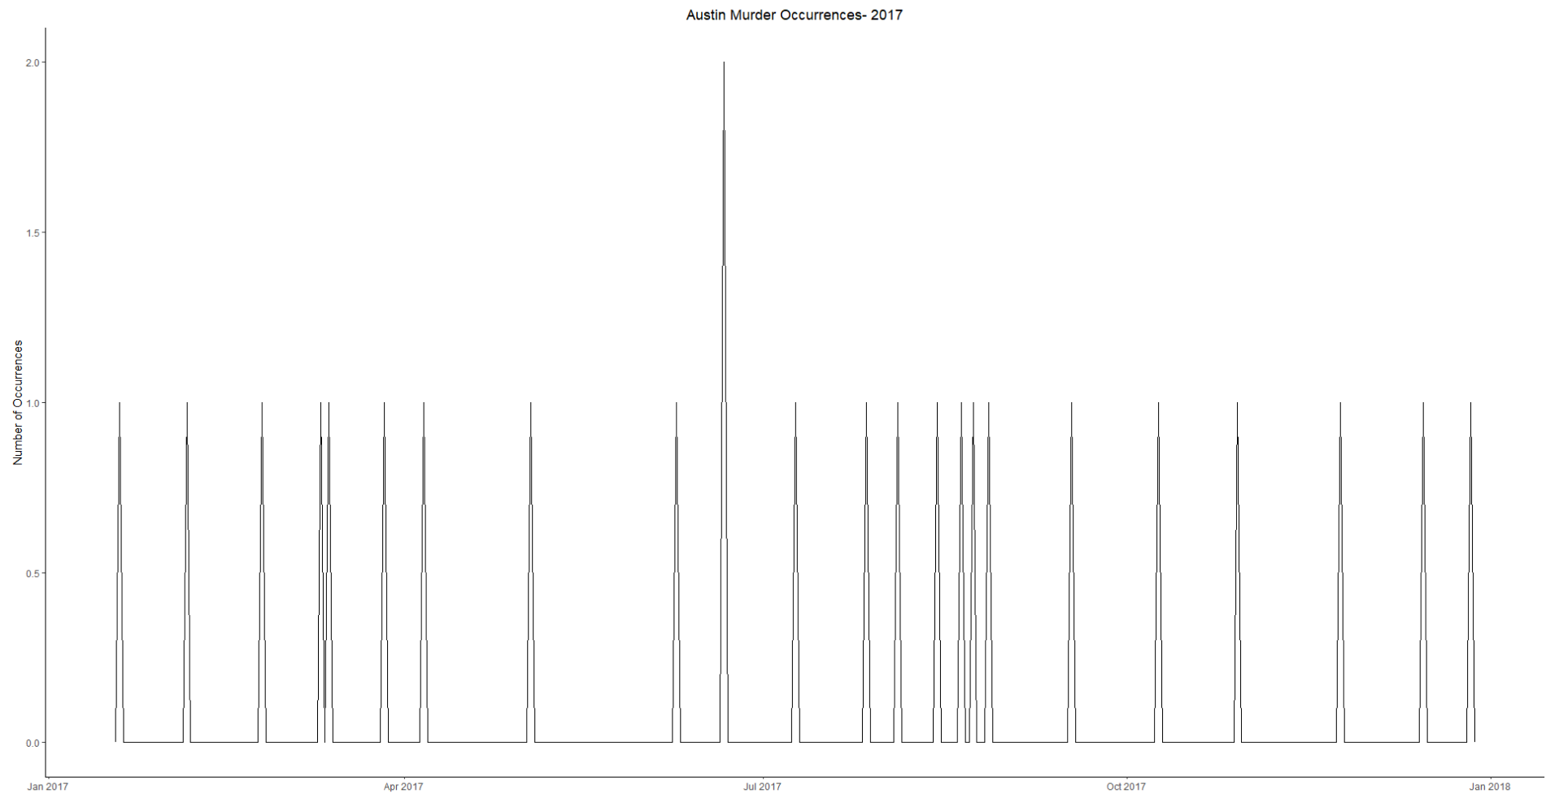
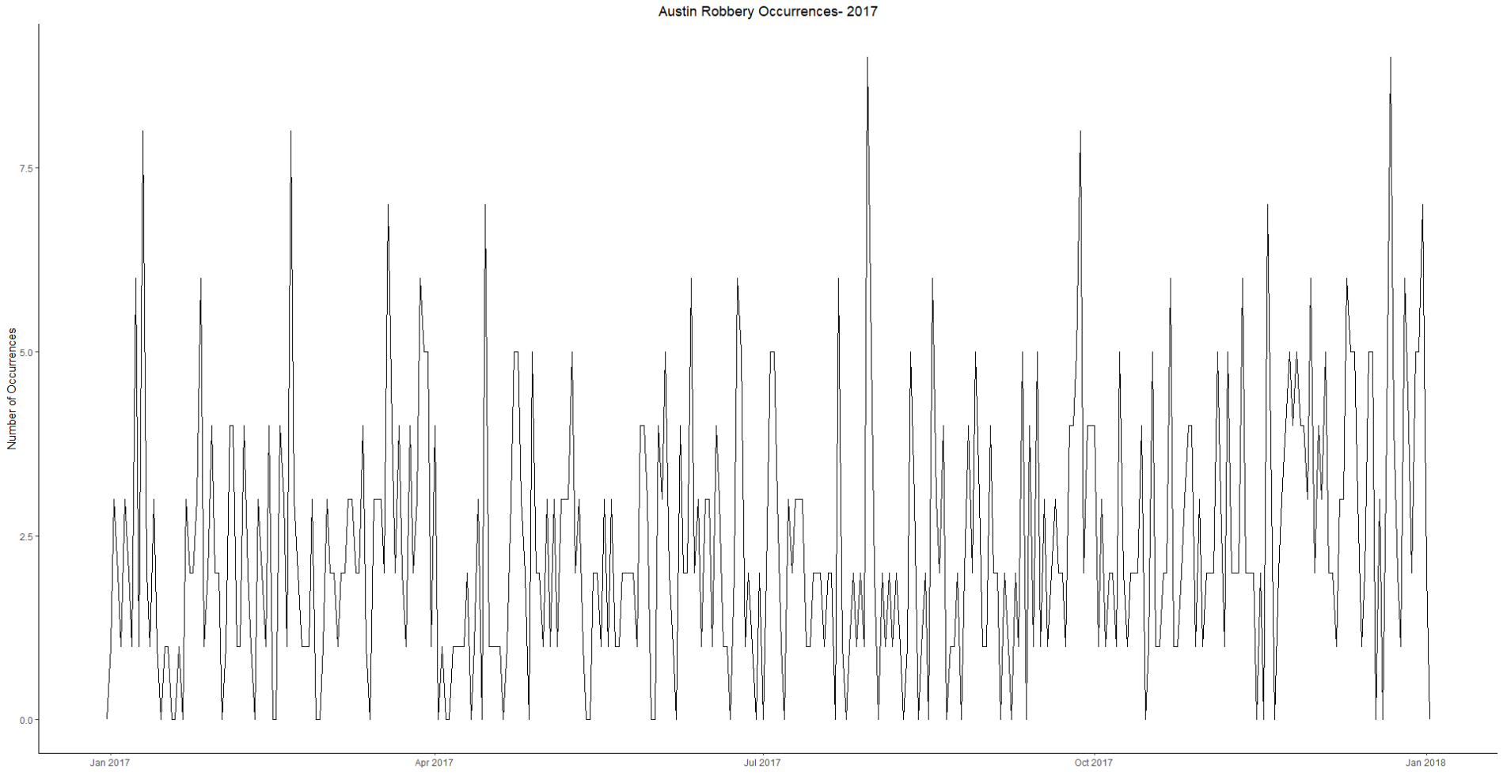

Slide 14
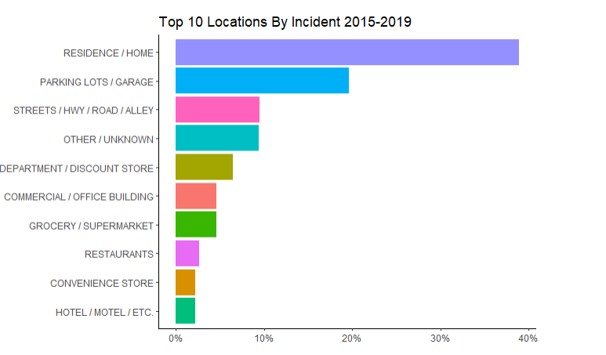
Question 3
Which locations are most associated with high crime rates?

Slide 15
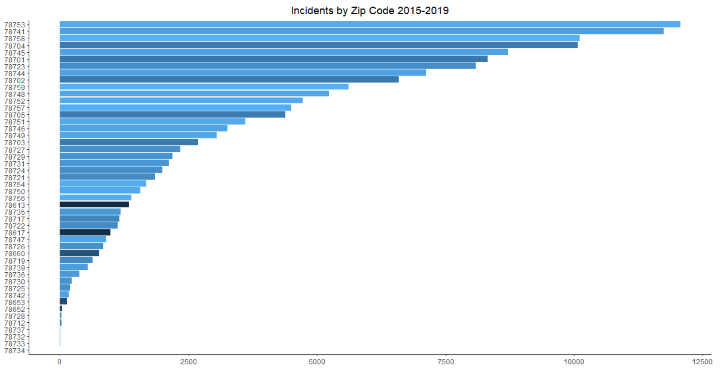

Slide 16
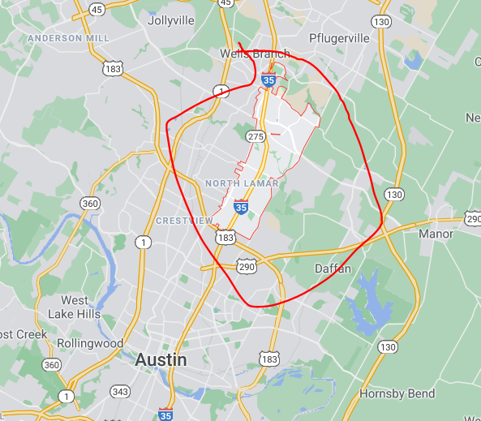
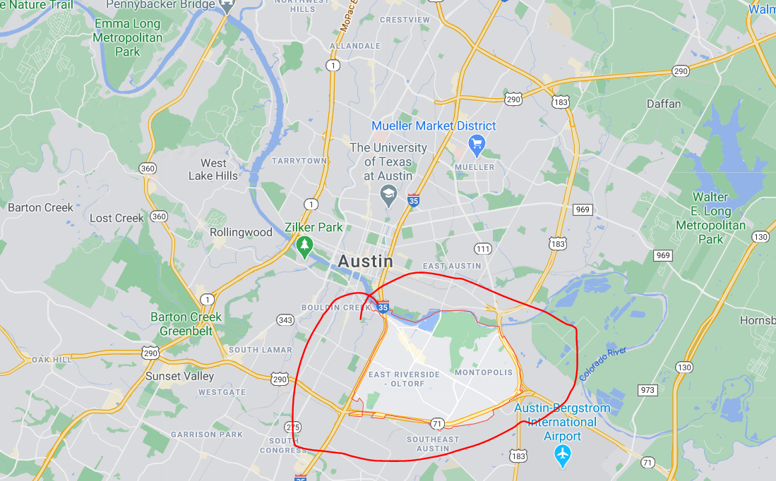
78753
78741

Slide 17
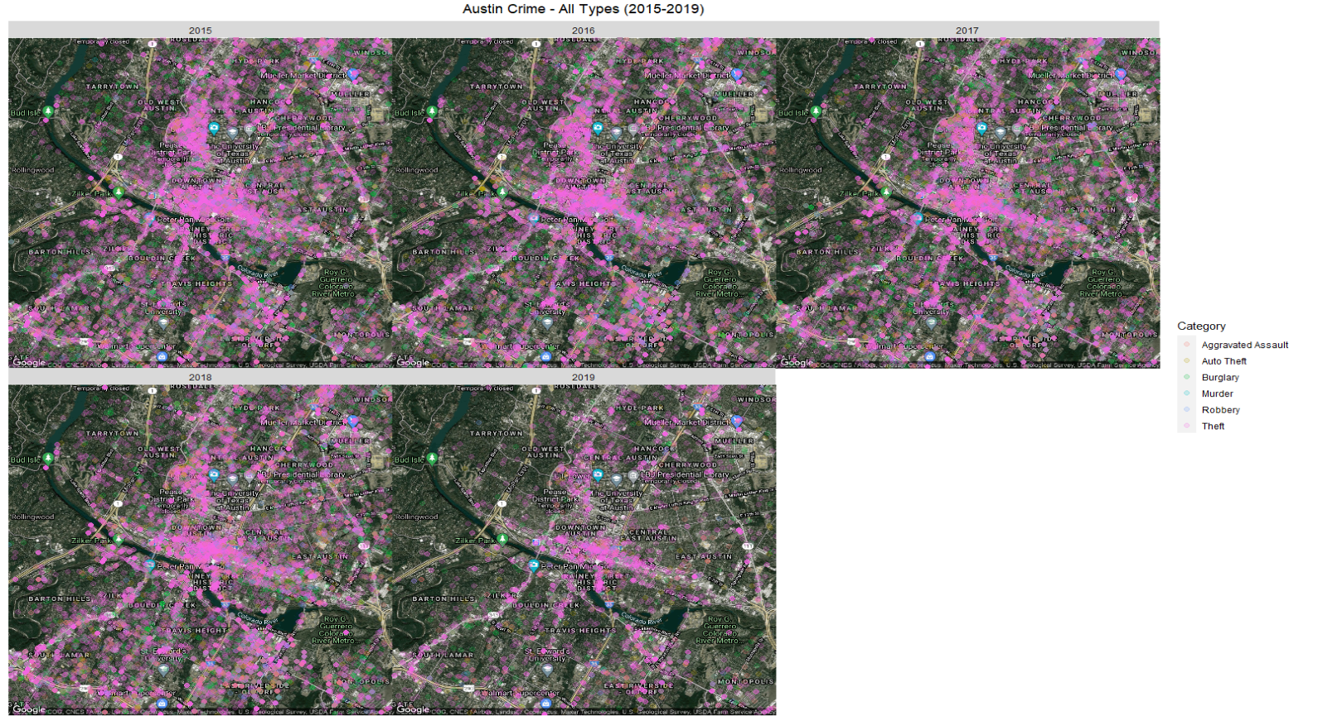
Question 4- Maps
Which areas in Austin are more affected by crime incidents?

Slide 18
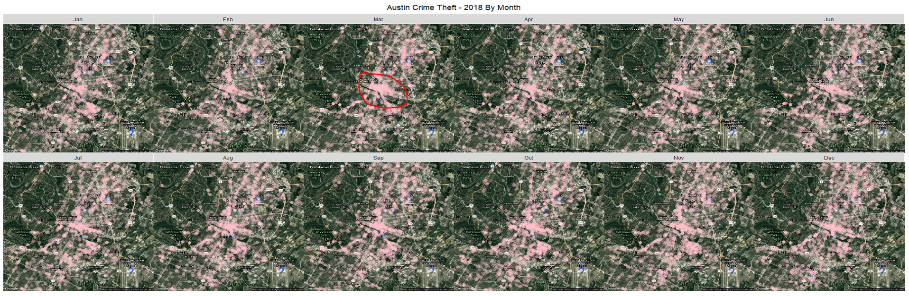

Slide 19
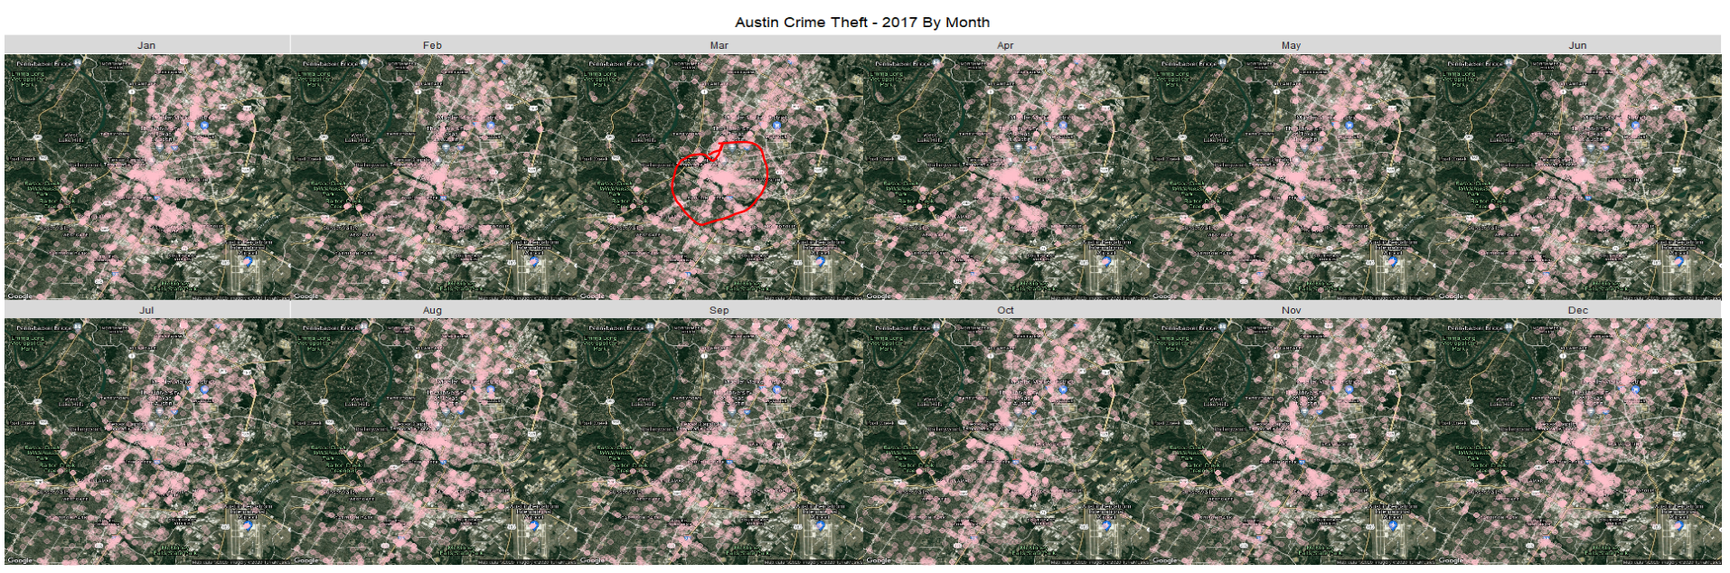

Slide 20
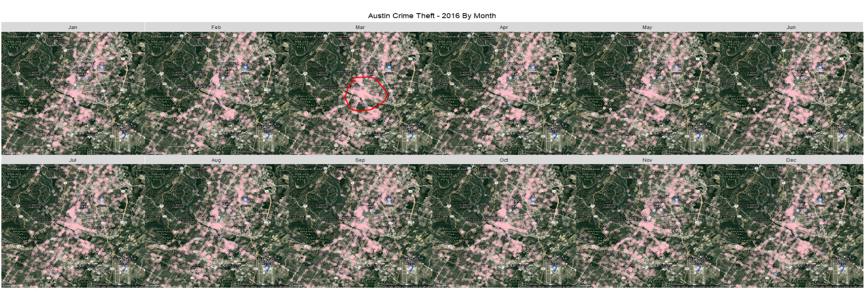

Slide 21
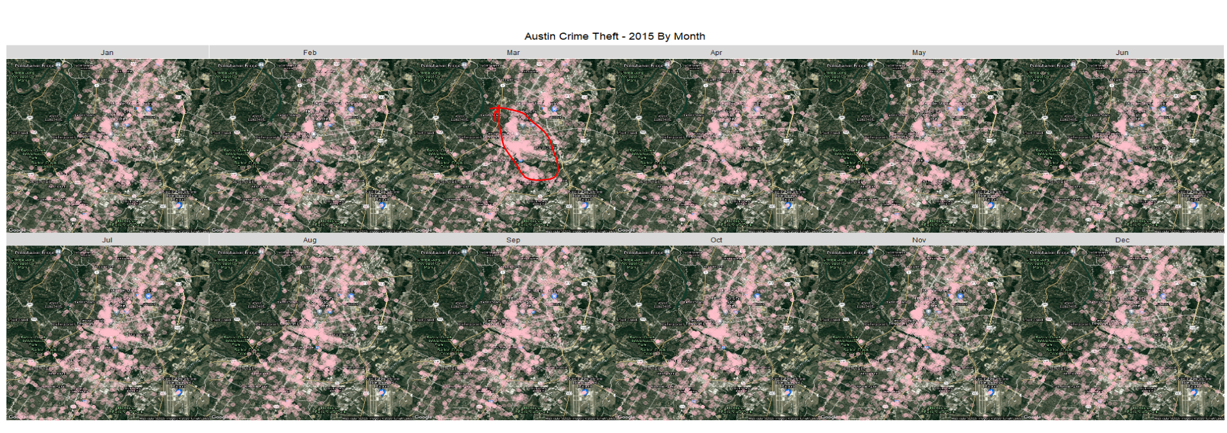

Slide 22

South by Southwest (SXSW)
Crime increased 50% in March 2015
146 arrests in 2015 during SXSW
Between 9pm-3am
Public Intoxication
Theft
Assault
Police force increase by 10%
Source:
https://thedailytexan.com/2016/03/21/increased-police-presence-attempts-to-counteract-high-crime-rates-during-sxsw

Slide 23
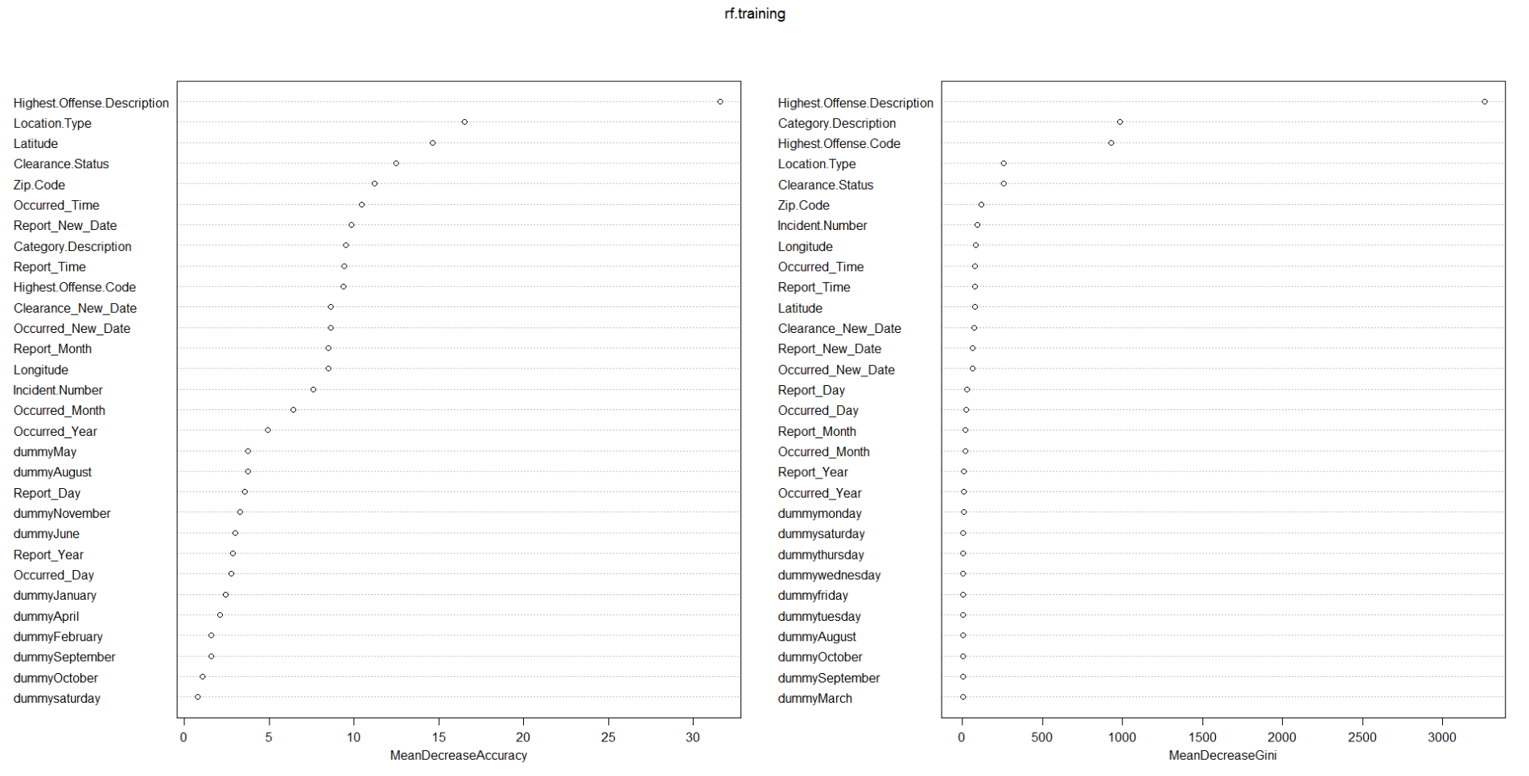
Question 5
Is it possible to predict whether crime will be associated with family violence?

Slide 24
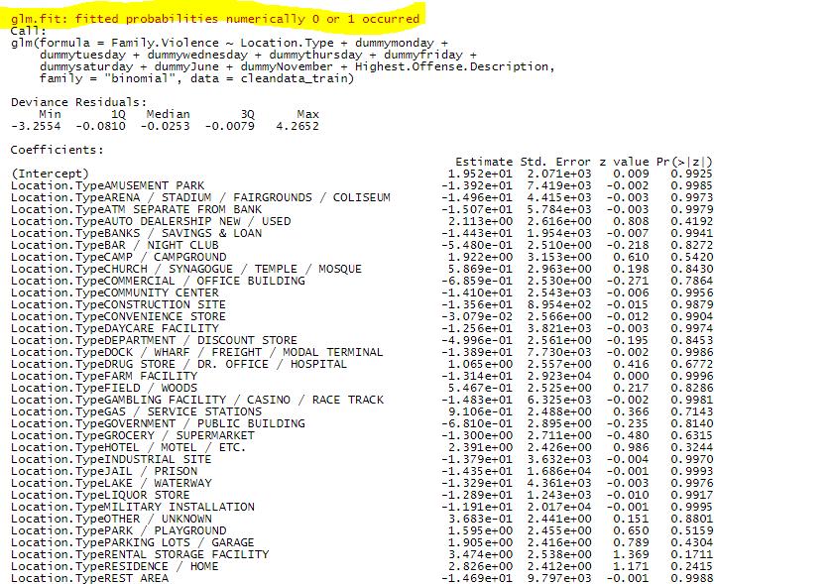
Logistic Regression - First Try

Slide 25
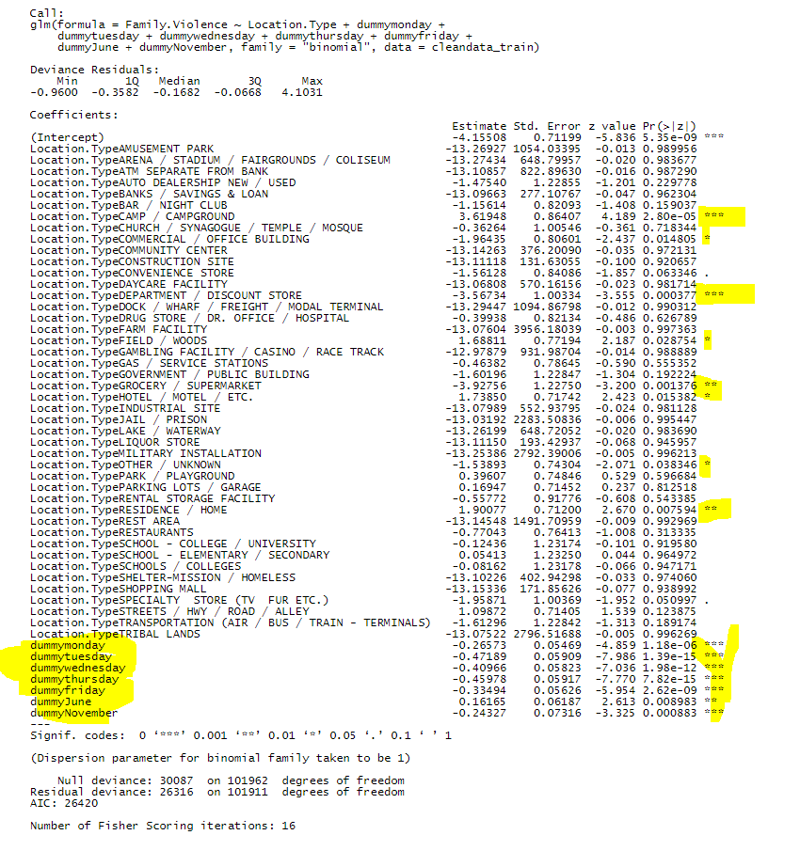
One More Time

Slide 26
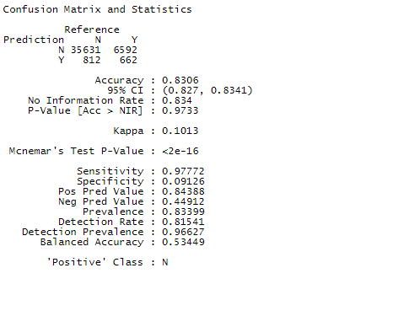
Confusion Matrix- Logistic Regression

Slide 27
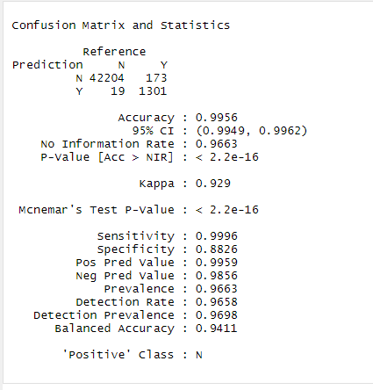
Confusion Matrix- Random Forest

Slide 28

Recommendations
Allocate resources towards crime theft
Crime theft increases between January-April
Highest: Theft
Lowest: Robbery, Murder
Most crimes take place in home
Concentrate on zip codes with highest incidents of theft
The Domain and South Austin
Theft likely to occur in March
Investigate significant variables for family violence:
Location
Weekdays
June/November

Slide 29

Email: duranrudolph@gmail.com

